Slide 1
TRIGONOMETRIC FUNCTIONS
Radian and Degree Measure
Trigonometric Functions
T. Functions of Complementary and supplementary Angles
T Functions of Sum Of angles
T functions of Double and Half Angles.
Trigonometric Equations (Principal & General Solutions

Slide 2
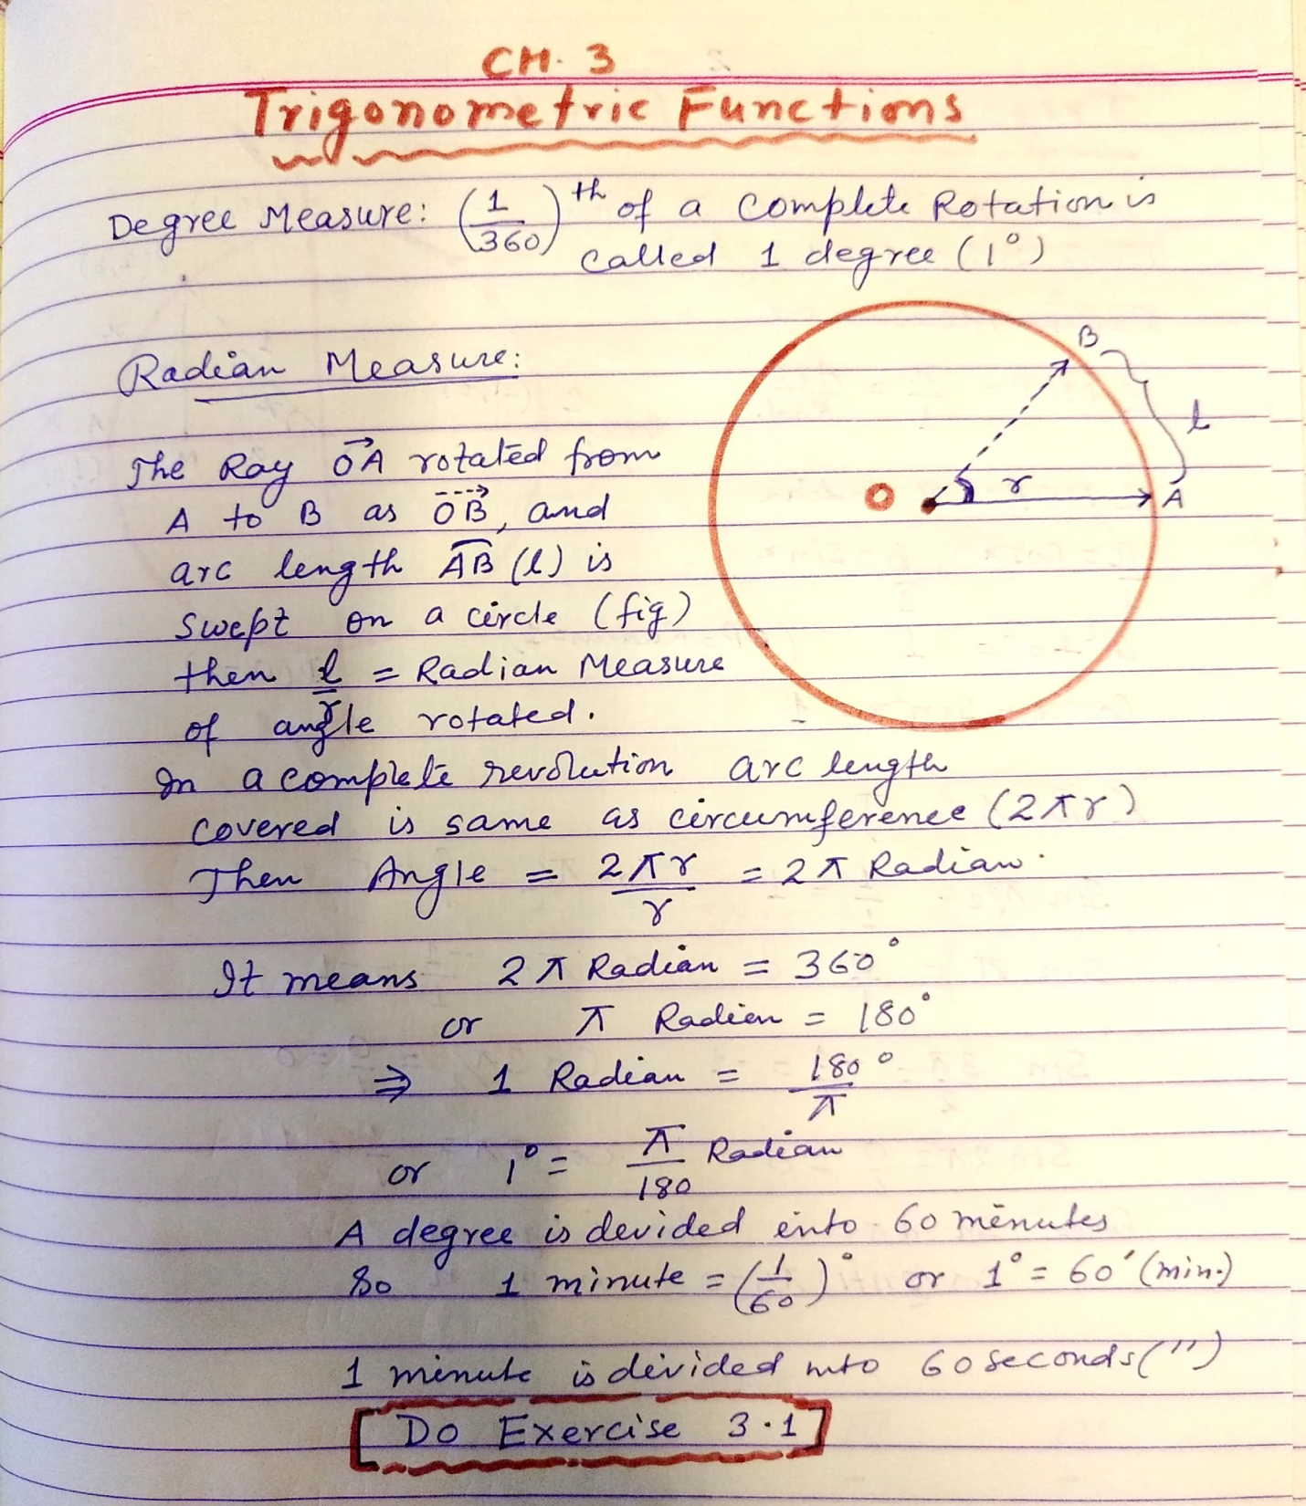

Slide 3
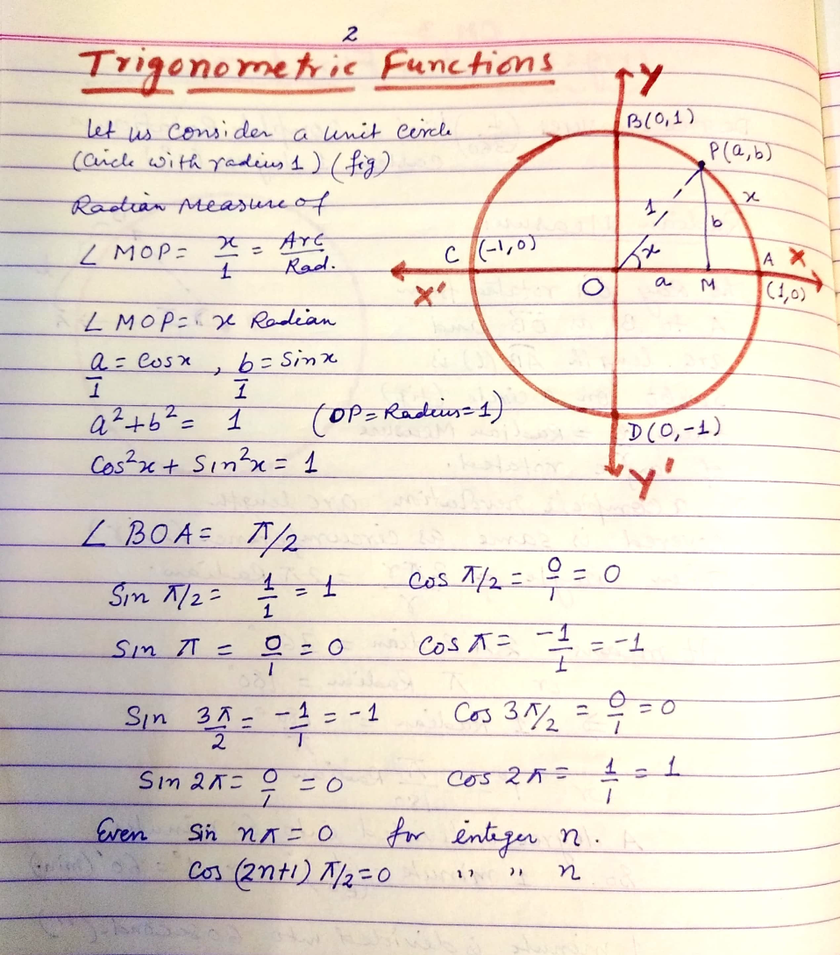

Slide 4
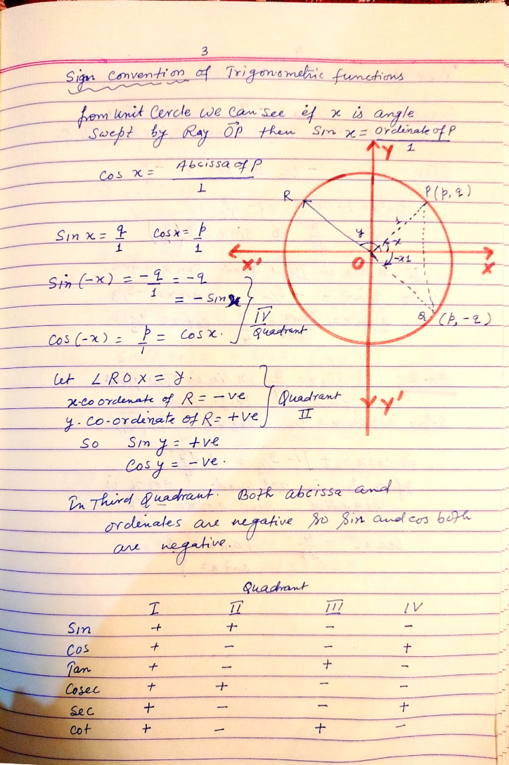

Slide 5
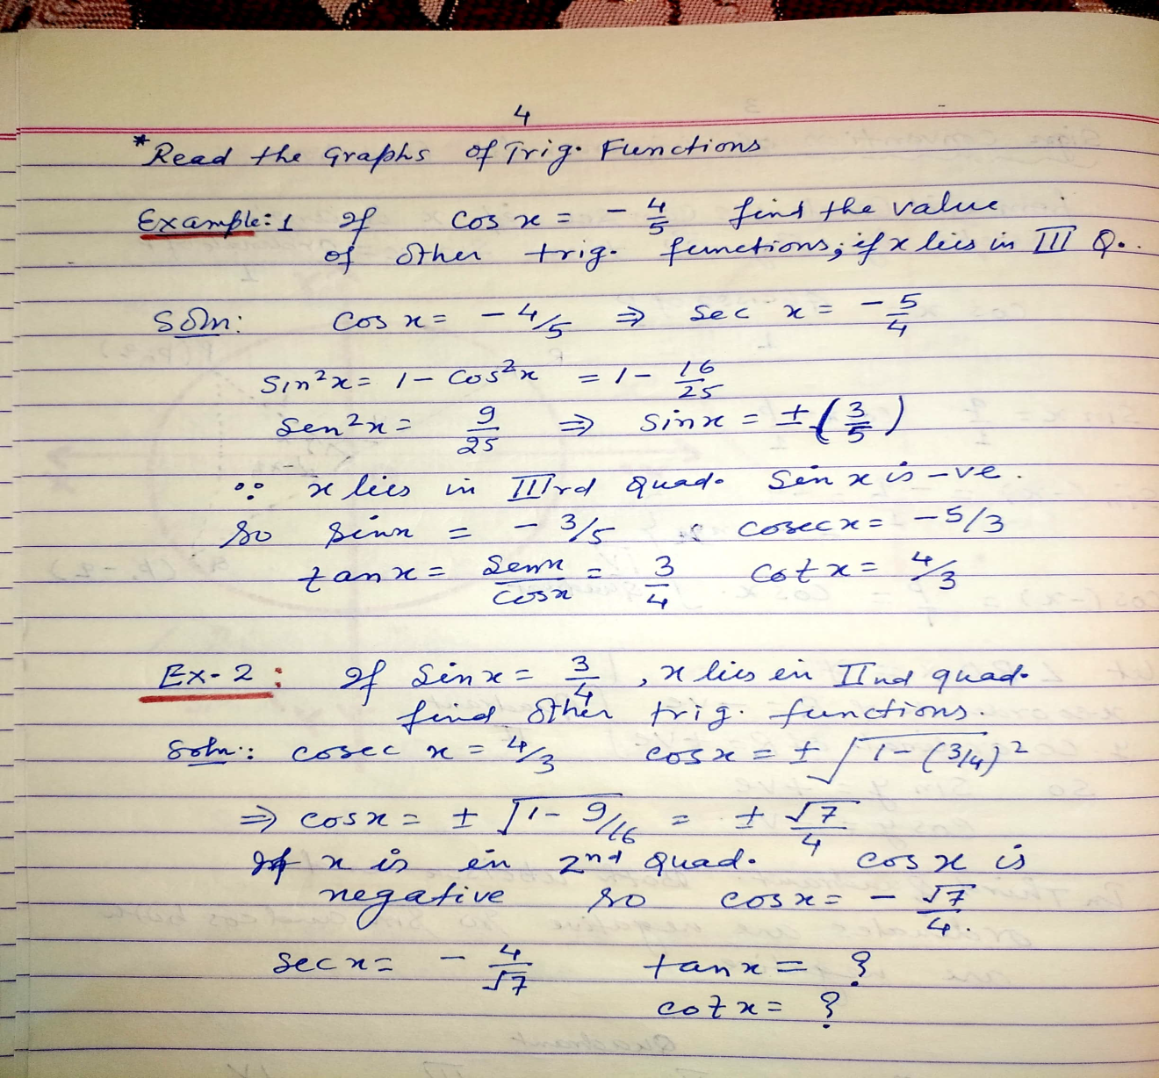

Slide 6
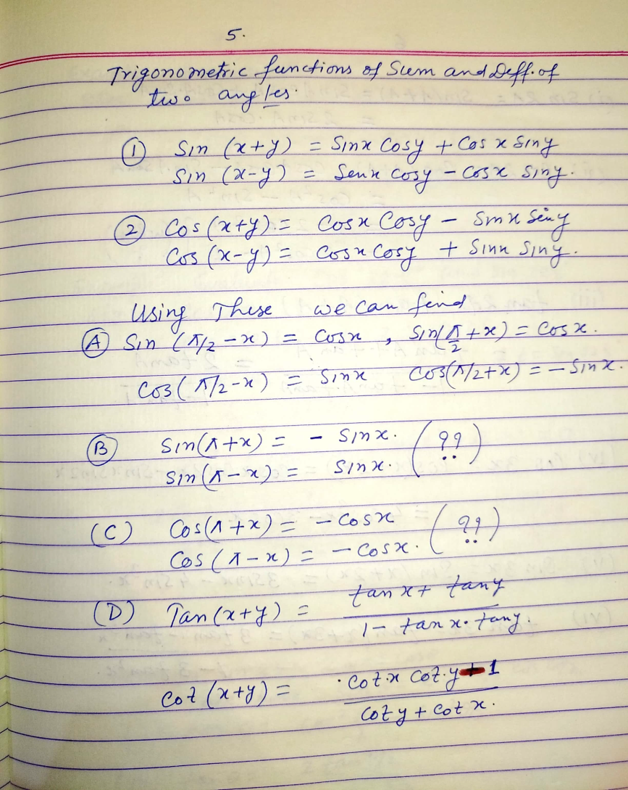

Slide 7
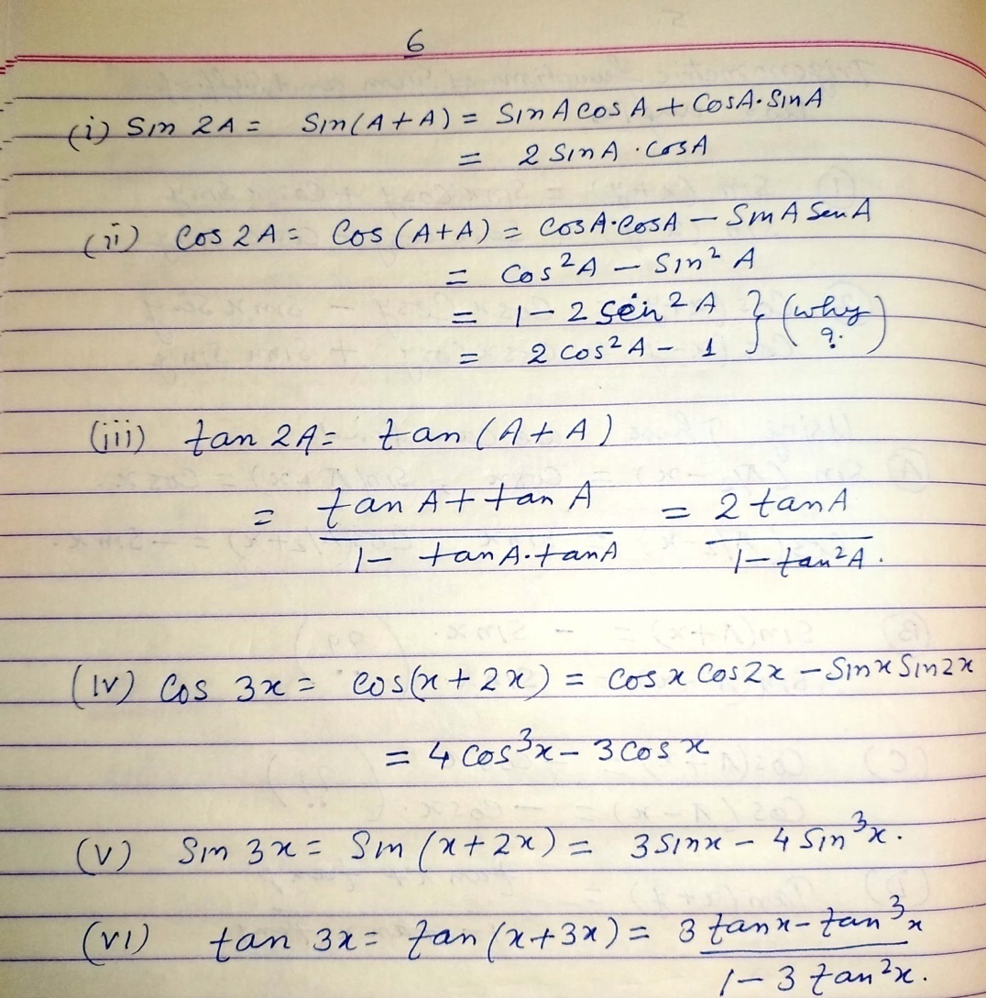

Slide 8
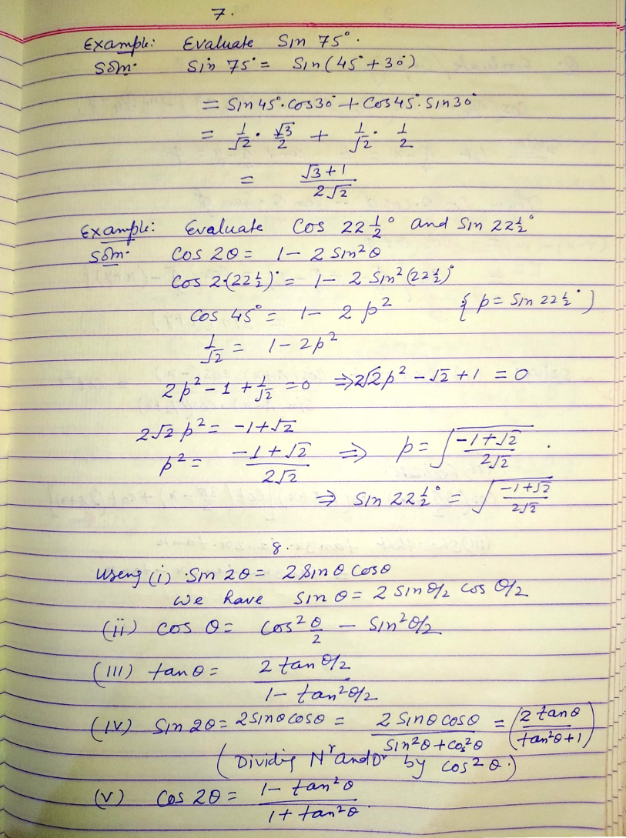

Slide 9
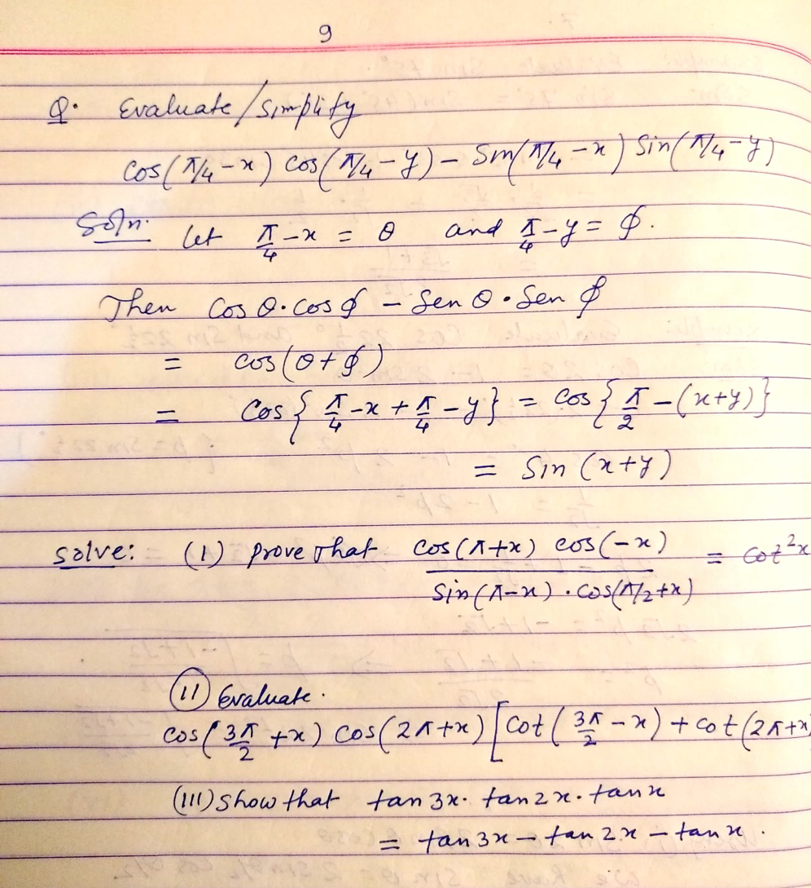

Slide 10
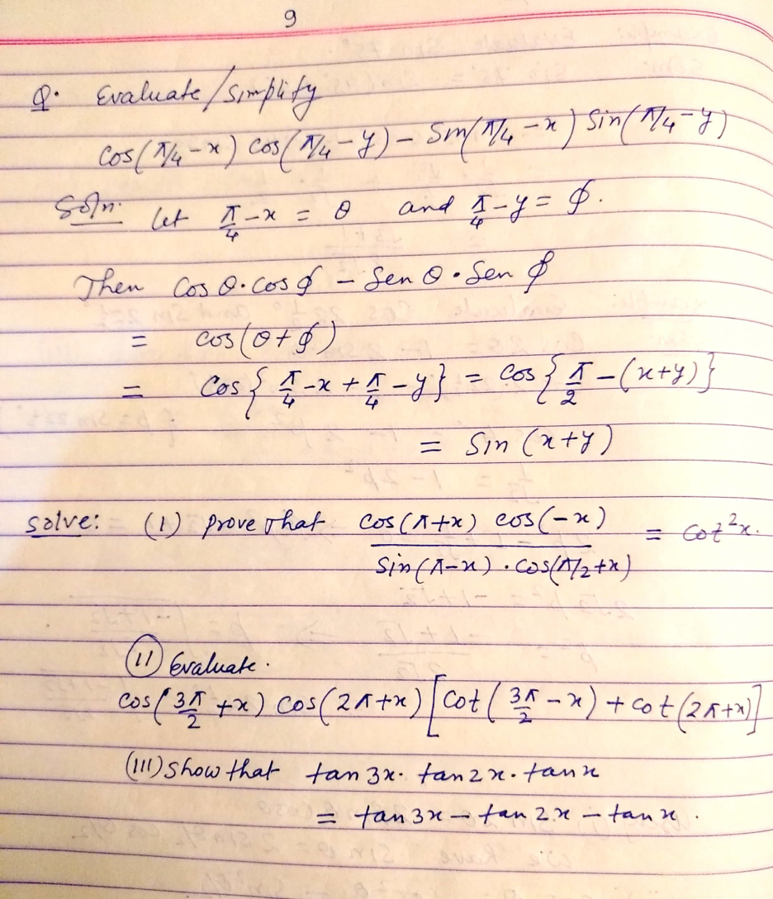

Slide 11
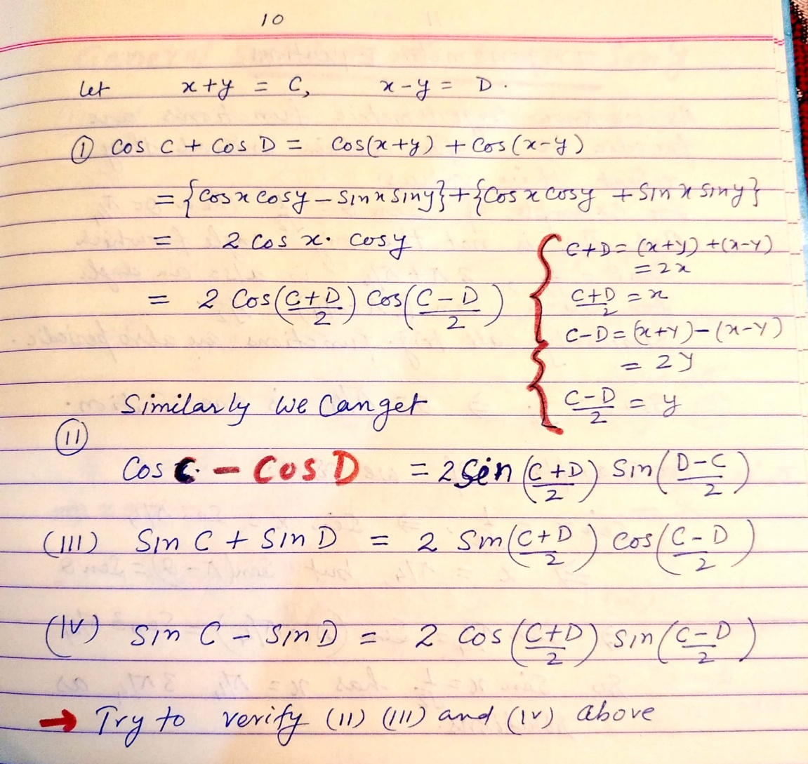

Slide 12
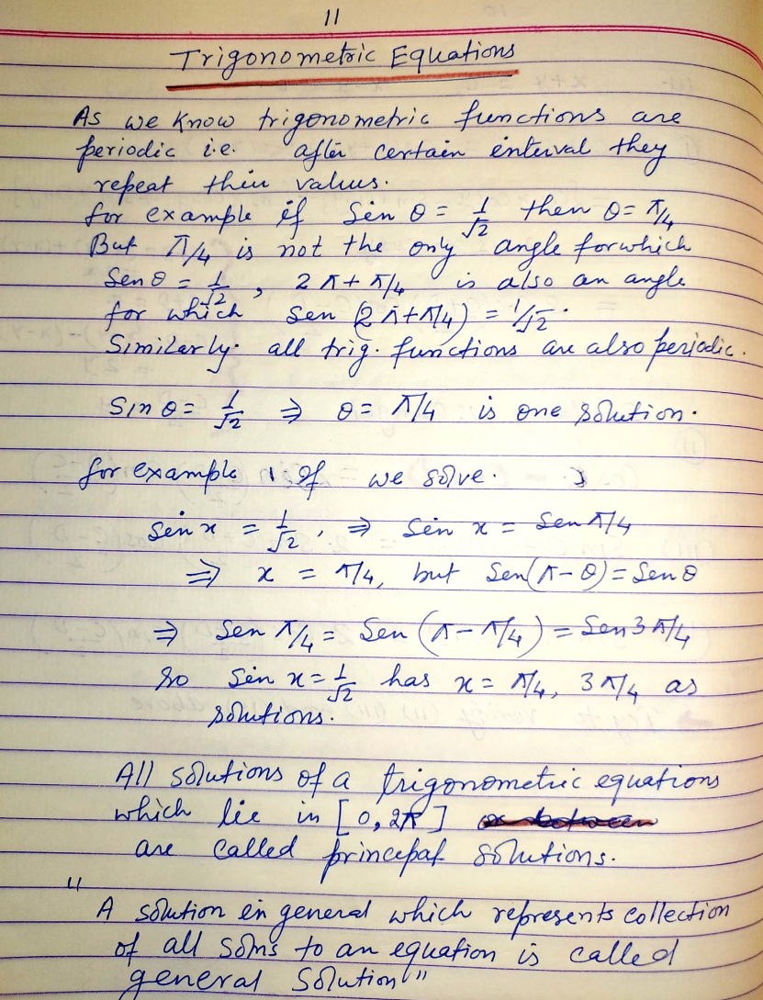

Slide 13
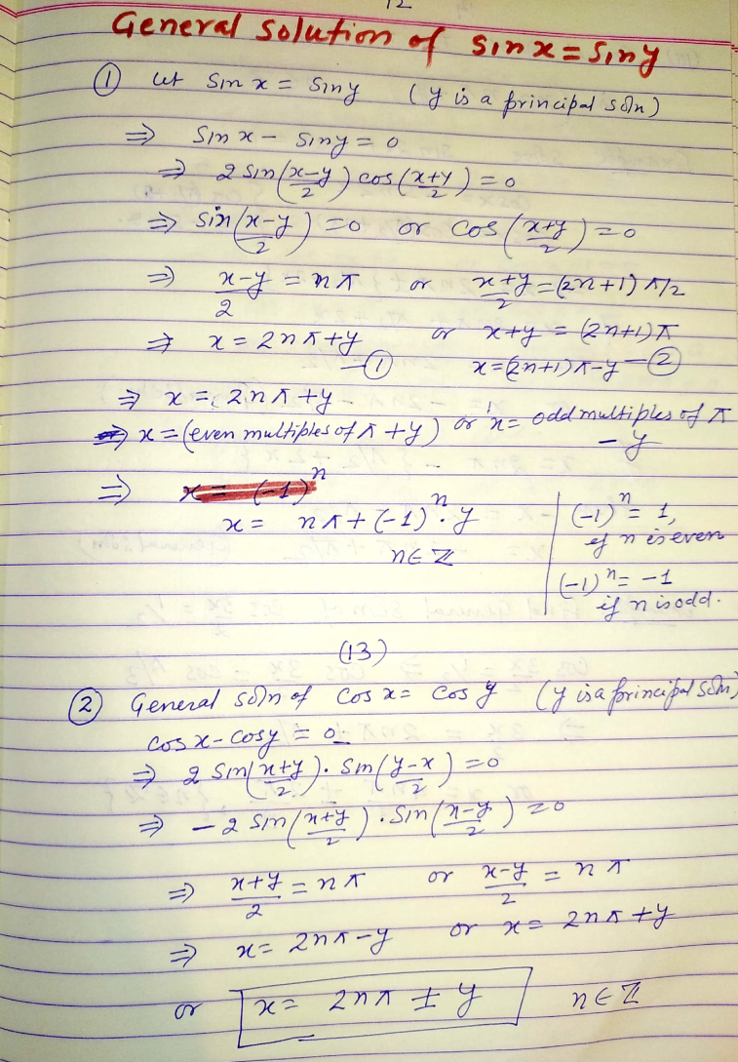

Slide 14
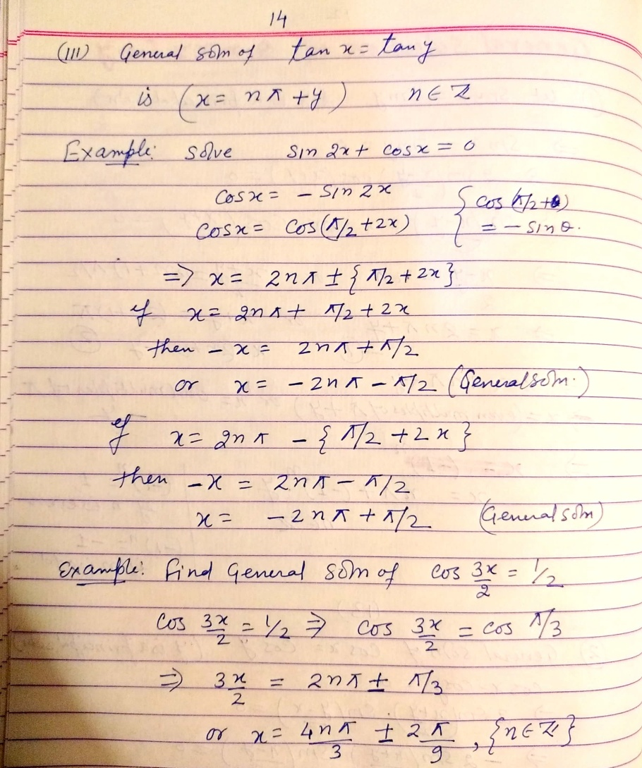

Slide 15
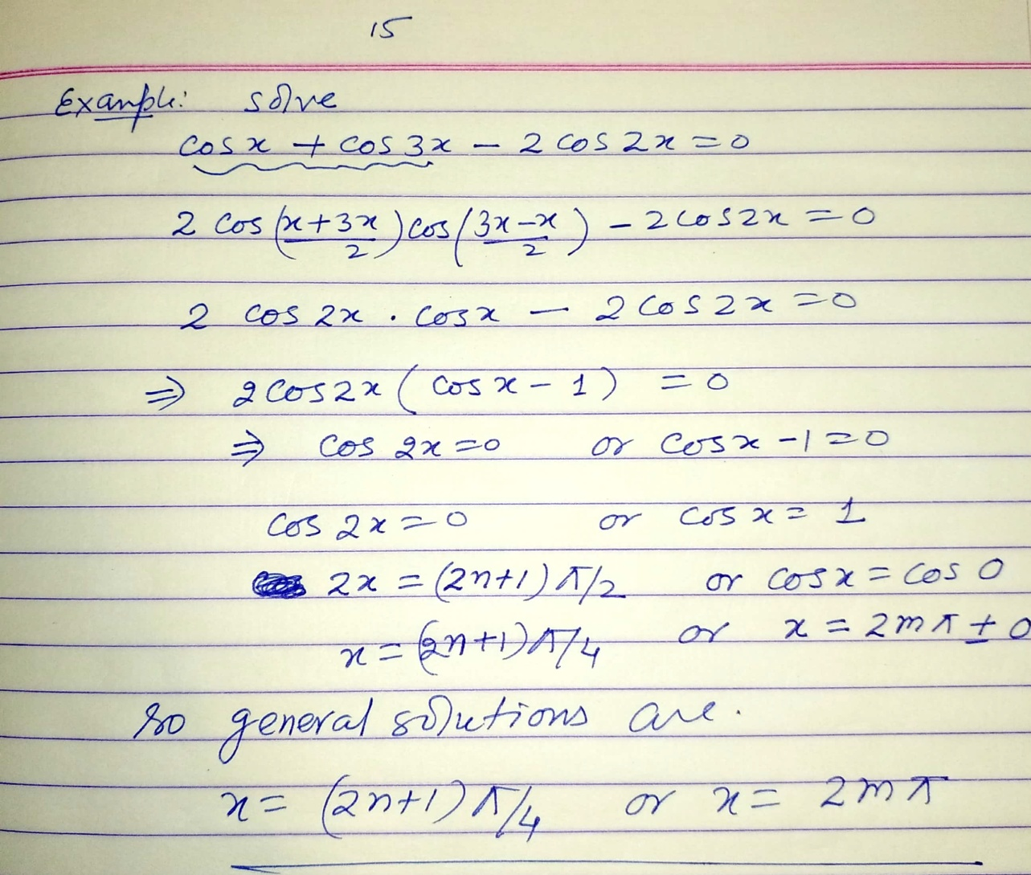

Slide 16
THANK YOU

